Slide 1
Discrimination of Normal and Abnormal Knee Joint VAG Signals Using EMD
Paper Id-92
2nd International Conference on
Computational Electronics for Wireless Communication
Authors name:- Abhishek Singh, Kapil Gupta, Varun Bajaj

Slide 2
Outlines
Introduction
Literature Survey
Motivation
Work Map
Result Obtained
Advantages & Future Scope
References

Slide 3
Introduction
The word VAG stands for Vibroarthrographic signals.
Knee is one of the largest joint of our body that joins (Femur & Tibia), and the signal VAG produced during the movement of leg (from flexion to extension).
VAG signals are non-stationary in nature.
Its frequency changes continuously.

Slide 4
Cont….
To record this signal we have to put the setup on the knee and told the patient to swing his leg from 0 to 140 degree and 140 to 0 degree back.

Slide 5
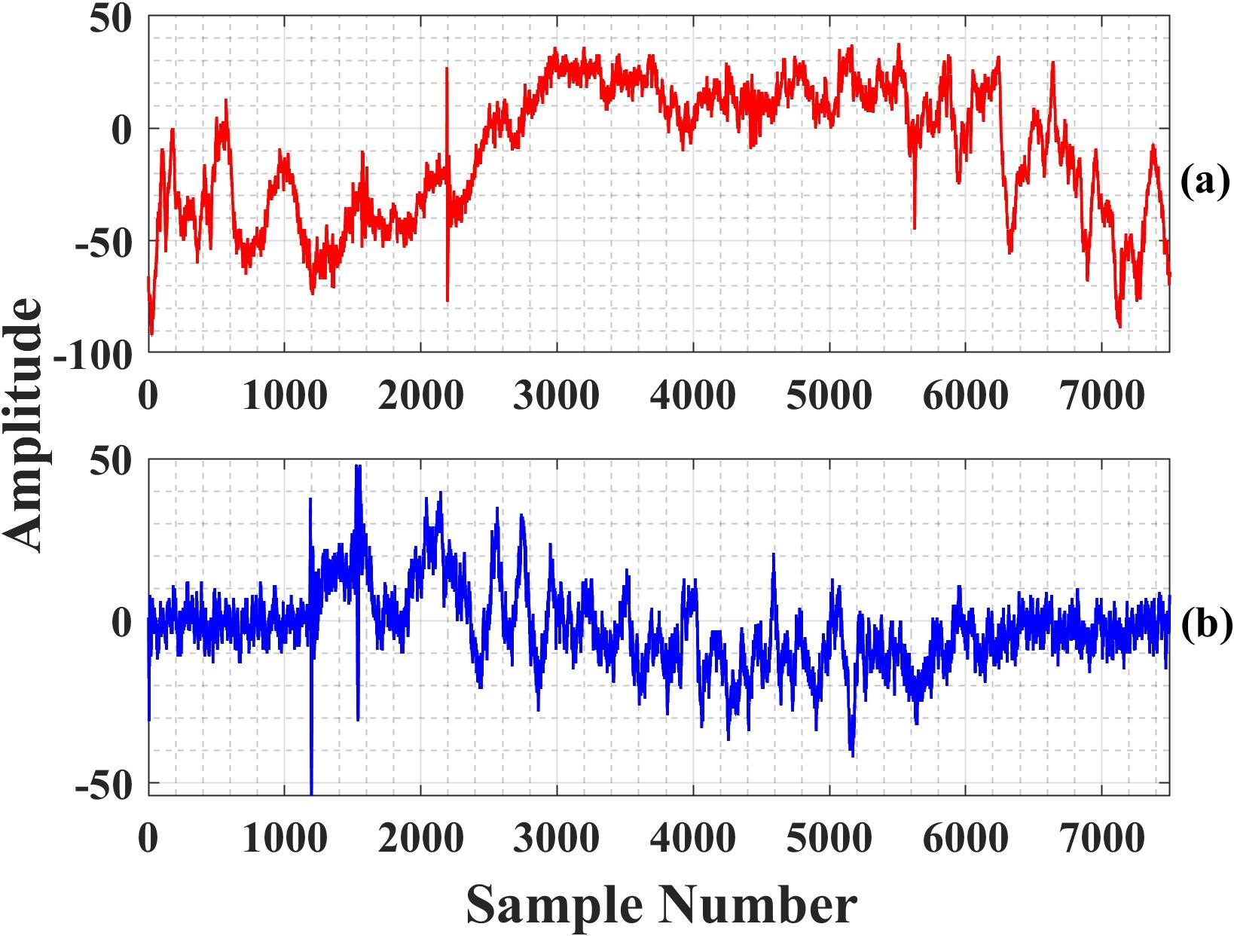
Graphical Representation of VAG
Fig.No:1
These are the graphical representation of VAG(one them is obtained from normal knee(a) and other from abnormal knee(b)

Slide 6
Literature Survey
References | Year | Titles | Observations
1. Rangaraj M. Rangayyan | 2010 | Screening of knee-joint vibroarthrographic signals using probability density functions estimated with Parzen windows | Build up the Understandings of VAG. And found unnecessary calculation complexity was used.
2. Manish Sharma, R.B .Pachori | 2018 | DDDTCWT based feature for automated screening for knee joints VAG signals. | Sub-band filtration technique is used for decomposition, mean data available in particular section of signal is used.
3. Manish Sharma, U. Rajendra Acharya | 2018 | Analysis of knee-joint vibroarthographic signals using bandwidth-duration localized three-channel filter bank | Latest accuracy quoted in the classification.(88%)

Slide 7
Cont…..
4. Mrunal M. Shidore Shreeram S. Athreya | 2021 | Screening of knee-joint vibroarthrographic signals using time and spectral domain features | Wavelet based decomposition is used to decompose the signal, in which some information where lost while decomposing of raw signal .

Slide 8
Motivation
To reduce the data losses during decomposition of signal.
To increase the classification accuracy of VAG signals by reducing calculation complexity.
In nowadays technique that are used to diagnosis the knees are X-ray scan , MRI scan and other invasive method are also used , but the issue with these technique are that patient have to wait to get the report.
And a concerned experts are also required to operate these heavy machines ,and these machines are also very expensive.

Slide 9
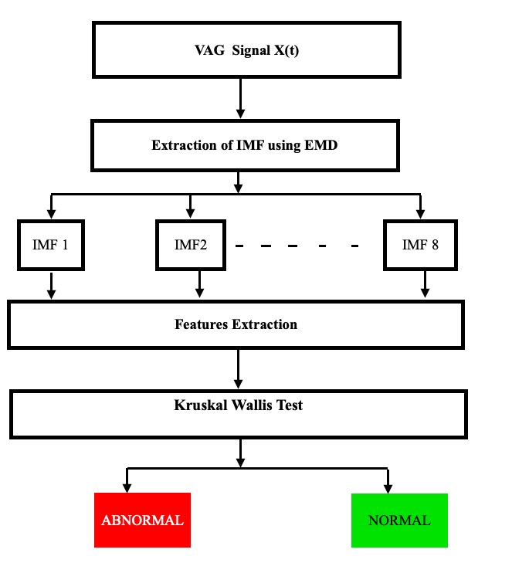
Work Flow
Fig No:-1

Slide 10
Data Set
The signal set that we took to proceed our work is a set of 89 signals (38 are ABNORMALs & 51 are NORMALs).
Signal is non-stationary in nature.
The signal was recorded in the laboratory of University of Calgary, Canada.
Sampling frequency of data set is 2Khz.
Recording time of signal is 4 sec.
And signal was pre-filtered (10Hz to 1000Hz) and then amplified .

Slide 11
Decomposition of Signals
EMD
EMD stands for Empirical Mode of Decomposition.
It decomposes the function into sum of IMFs.
Each IMFs have to satisfy two basic conditions.
The number of extrema & zero crossing must be equal or differ max by one.
At any point, mean value of the envelope define by local minima & and envelope define by local maxima is zero.

Slide 12
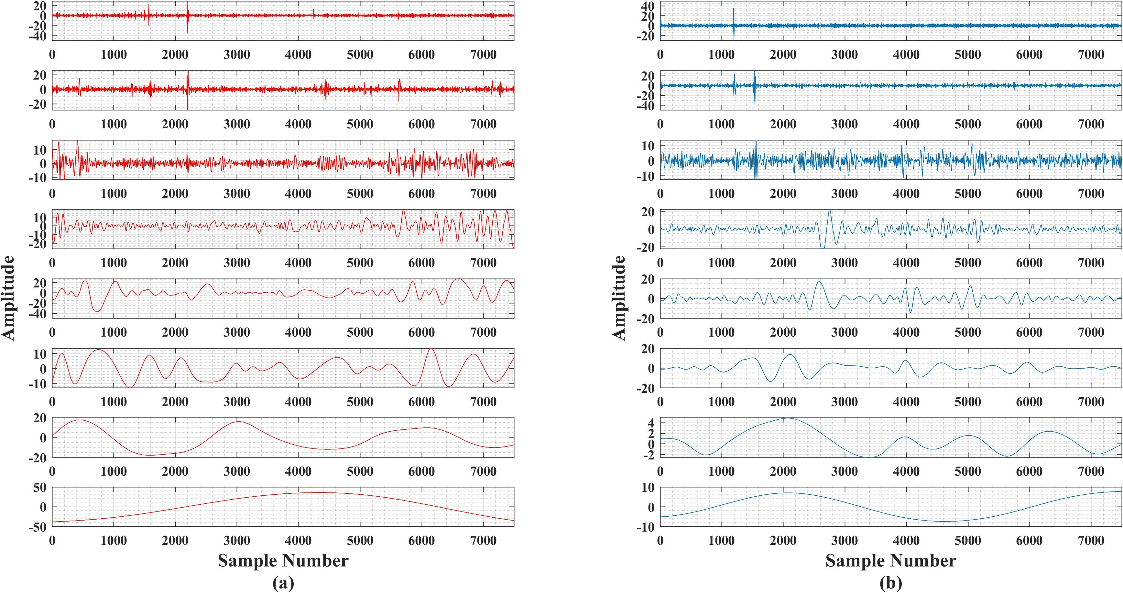
Fig No:-2

Slide 13
Features Extraction
Mean
Root Mean Squared(RMS)
Standard Deviation
Shanon Entropy (ShanEn)
Log Energy Entropy (LogEn)
Threshold Entropy(TE)
Sure Entropy(SE)
Norm Entropy(NE)
Permutation Entropy(PE)
Skewness(Sk)
Kurtosis(K)
Simple Squared Integral(SSI)

Slide 14
Kruskal-Wallis Test(KW Test)
The KW test is a more generalized form of two class Wilcoxon rank test and one way analysis of variance (ANOVA) test.
KW is a non parametric statistical test that compares the contempts between two or more distinguishable sampled classes on single.
The result of KW test shown by the help of Box Plots.

Slide 15
Table No:-1
IMF No. | ShanEn | LogEn | NE | TE | PE | SrE
IMF-1 | 0.0065 | 2 × 10⁻⁵ | 0.0002 | 0.0002 | 0.0449 | 1.28 × 10⁻⁵
IMF-2 | 0.0573 | 0.0472 | 0.0377 | 0.0001 | 0.7553 | 0.0407
IMF-3 | 0.868 | 0.2531 | 0.7084 | 0.0039 | 0.4001 | 0.2531
IMF-4 | 0.4298 | 0.5061 | 0.3136 | 0.4703 | 0.0018 | 0.3943
IMF-5 | 0.4671 | 0.2707 | 0.3237 | 0.0428 | 0.0016 | 0.1735
IMF-6 | 0.9255 | 0.8926 | 0.9503 | 0.3448 | 0.2619 | 0.9255
IMF-7 | 0.7711 | 0.868 | 0.9669 | 0.8762 | 0.7474 | 0.9388
IMF-8 | 0.9751 | 0.5962 | 0.8031 | 0.589 | 0.7632 | 0.8926

Slide 16
Table No:-2
IMF No. | ShanEn | LogEn | NE | TE | PE | SrE
IMF-1 | 0.0065 | 2 × 10⁻⁵ | 0.0002 | 0.0002 | 0.0449 | 1.28 × 10⁻⁵
IMF-2 | 0.0573 | 0.0472 | 0.0377 | 0.0001 | 0.7553 | 0.0407
IMF-3 | 0.868 | 0.2531 | 0.7084 | 0.0039 | 0.4001 | 0.2531
IMF-4 | 0.4298 | 0.5061 | 0.3136 | 0.4703 | 0.0018 | 0.3943
IMF-5 | 0.4671 | 0.2707 | 0.3237 | 0.0428 | 0.0016 | 0.1735
IMF-6 | 0.9255 | 0.8926 | 0.9503 | 0.3448 | 0.2619 | 0.9255
IMF-7 | 0.7711 | 0.868 | 0.9669 | 0.8762 | 0.7474 | 0.9388
IMF-8 | 0.9751 | 0.5962 | 0.8031 | 0.589 | 0.7632 | 0.8926

Slide 17
Future Scope & Advantages
We may commercialize the product by developing a wearable set up .
Also trying to increase its efficiency to get more better result.
This method makes the process easier for the diagnosis of knee.
And also saves times too in comparison of X-ray, MRI and other non-invasive as well as invasive method.

Slide 18
References
Jac Fredo, A. R., Josena, T. R., Palaniappan, R., Mythili, A. (2017). Classification of normal and knee joint disorder vibroarthrographic signals using multifractals and support vector machines. Biomedical Engineering: Applications, Basis and Communications, 29(03), 1750016
Sharma, M., Sharma, P., Pachori, R. B., M Gadre, V. (2019). Double density dualtree complex wavelet transform-based features for automated screening of knee-joint vibroarthrographic signals. In Machine intelligence and signal analysis (pp. 279-290). Springer, Singapore.
Krishnan, S., Rangayyan, R. M., Bell, G. D., Frank, C. B. (2000). Adaptive timefrequency analysis of knee joint vibroarthrographic signals for noninvasive screening of articular cartilage pathology. IEEE Transactions on Biomedical Engineering, 47(6), 773-783.
Krishnan, Sridhar, (1999)., Adaptive signal processing techniques for analysis of knee joint vibroarthrographic signals., University of Calgary, 1–263, 10.11575/PRISM/23830
Umapathy, K., Krishnan, S. (2006). Modified local discriminant bases algorithm andits application in analysis of human knee joint vibration signals. IEEE Transactions on Biomedical Engineering, 53(3), 517-523.
Rangayyan, R. M., Wu, Y. F. (2008). Screening of knee-joint vibroarthrographicsignals using statistical parameters and radial basis functions. Medical and biological engineering and computing, 46(3), 223-232.
Rangayyan, R. M., Oloumi, F., Wu, Y., Cai, S. (2013). Fractal analysis of knee-jointvibroarthrographic signals via power spectral analysis. Biomedical Signal Processing and Control, 8(1), 23-29.
Shidore, M. M., Athreya, S. S., Deshpande, S., Jalnekar, R. (2021). Screeningof knee-joint vibroarthrographic signals using time and spectral domain features. Biomedical Signal Processing and Control, 68, 102808.
Balajee, A., Venkatesan, R. (2021). Machine learning based identification and classification of disorders in human knee joint–computational approach. Soft Computing, 25(20), 13001-13013.
Rangayyan, R. M., Wu, Y. (2010). Screening of knee-joint vibroarthrographic signals using probability density functions estimated with Parzen windows. Biomedical Signal Processing and Control, 5(1), 53-58.

Slide 19
Conti
Mascarenhas, E., Nalband, S., Fredo, A. J., Prince, A. A. (2020, February). Analysis and Classification of Vibroarthrographic Signals using Tuneable ‘Q’Wavelet Transform. In 2020 7th International Conference on Signal Processing and Integrated Networks (SPIN) (pp. 65-70). IEEE.
Rangayyan, R. M., Krishnan, S., Bell, G. D., Frank, C. B., Ladly, K. O. (1997). Parametric representation and screening of knee joint vibroarthrographic signals. IEEE Transactions on Biomedical Engineering, 44(11), 1068-1074.
Rangayyan, R. M., Wu, Y. (2009). Analysis of vibroarthrographic signals withfeatures related to signal variability and radial-basis functions. Annals of biomedical engineering, 37(1), 156-163.
Bajaj, V., Pachori, R. B. (2011). Classification of seizure and nonseizure EEGsignals using empirical mode decomposition. IEEE Transactions on Information Technology in Biomedicine, 16(6), 1135-1142.
Pachori, R. B., Bajaj, V. (2011). Analysis of normal and epileptic seizure EEGsignals using empirical mode decomposition. Computer methods and programs in biomedicine, 104(3), 373-381.
Bajaj, V., Pachori, R. B. (2012). EEG signal classification using empirical mode decomposition and support vector machine. In Proceedings of the International Conference on Soft Computing for Problem Solving (SocProS 2011) December 2022, 2011 (pp. 623-635). Springer, New Delhi.
Gupta, K., Khare, S. K., Bajaj, V., Ansari, I. A. (2021). Automatic detection of hypertension by flexible analytic wavelet transform using electrocardiogram signals. High Performance Computing for Intelligent Medical Systems, 1-1 to 1-18.
Machado, M., Flores, P., Claro, J. C., Ambro´sio, J., Silva, M., Completo, A.,Lankarani, H. M. (2010). Development of a planar multibody model of the human knee joint. Nonlinear Dynamics, 60(3), 459-478.

Slide 20
THANK YOU

